Slide 1
Front End Engineering-I Project
Team Details: SURVEY FORM PROJECT
TEAM:
Pranya: 2210990670
PRASHANT: 2210990671
Pratham Garg: 2210990672
Pratham /khanna: 2210990673
Faculty Coordinator: Dr. Mandeep Kaur
:
Chitkara University Institute of Engineering and Technology,
Chitkara University, Punjab

Slide 2
Table of Contents
Introduction
Problem Statement
Technical Details
Key Features
Project Highlights
Bonus Feature(optional)
Conclusion
References/Links used

Slide 3
Introduction
SURVEY FORM
G-27/T-3
Pranya
PRASHANT
Pratham Garg
Pratham Khanna
BRIEF OVERVIEW: A survey form can gather information on students and faculty, including contact details and programming proficiency, to facilitate collaboration on projects and research in the university.

Slide 4
Problem Statement
The problem this project aims to solve is the need for an efficient way to gather and maintain relevant information about students and faculty in a university, including their contact details and programming proficiency, to facilitate collaboration on projects and research.

Slide 5
Technical Details
This project used HTML and CSS to create a survey form page. HTML provided the structure for the form, including input fields for text, checkboxes, and dropdown menus to collect a wide range of data. CSS was then applied to enhance the form's appearance using design elements such as colors, fonts, spacing, and layout. This styling made the form look more professional and user-friendly, making it easier for users to navigate and respond to questions in an organized and straightforward manner.

Slide 6
Key Features
User-friendly interface: it’s a well-designed survey form which is easy to navigate and user-friendly, making it simple for respondents to complete the form and provide their feedback.
Customizable fields: Survey form project allows customization of fields to meet specific data collection requirements. This includes options for multiple choice questions, text fields, dropdown menus, and more.
Analytics and reporting: The survey form has the capability to collect and analyze data and generate reports, providing insights and understanding of the survey results.
Accessibility: The survey is designed to be accessible to all users, this includes making use of proper HTML markup and providing alt tags for images.

Slide 7
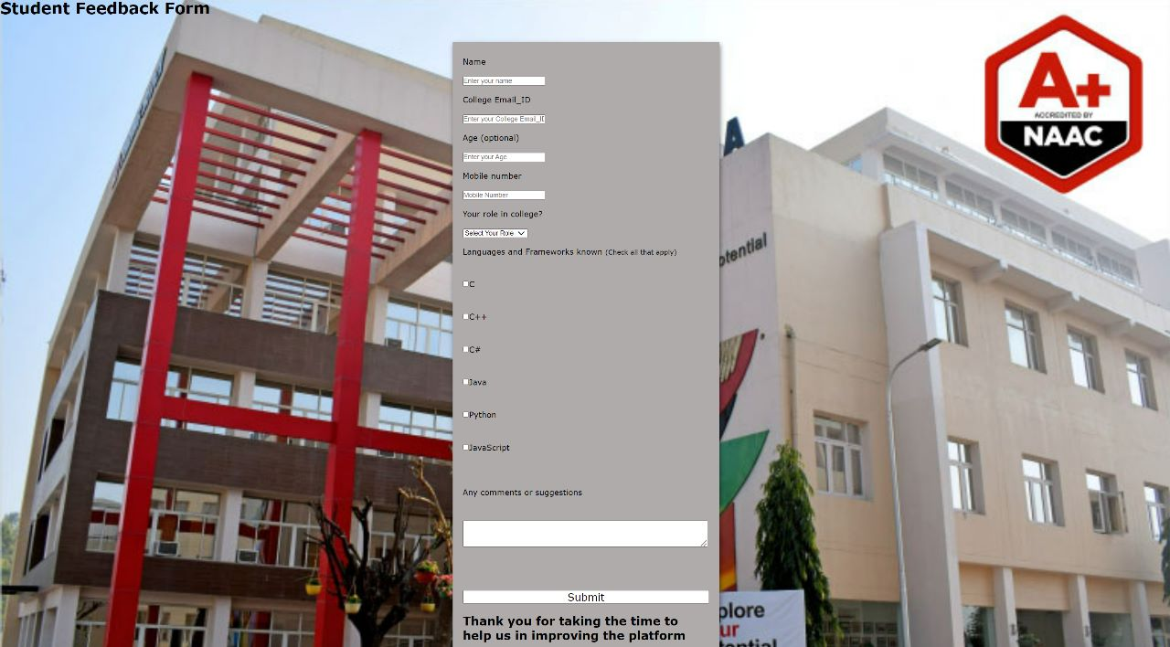
Project Highlights

Slide 8
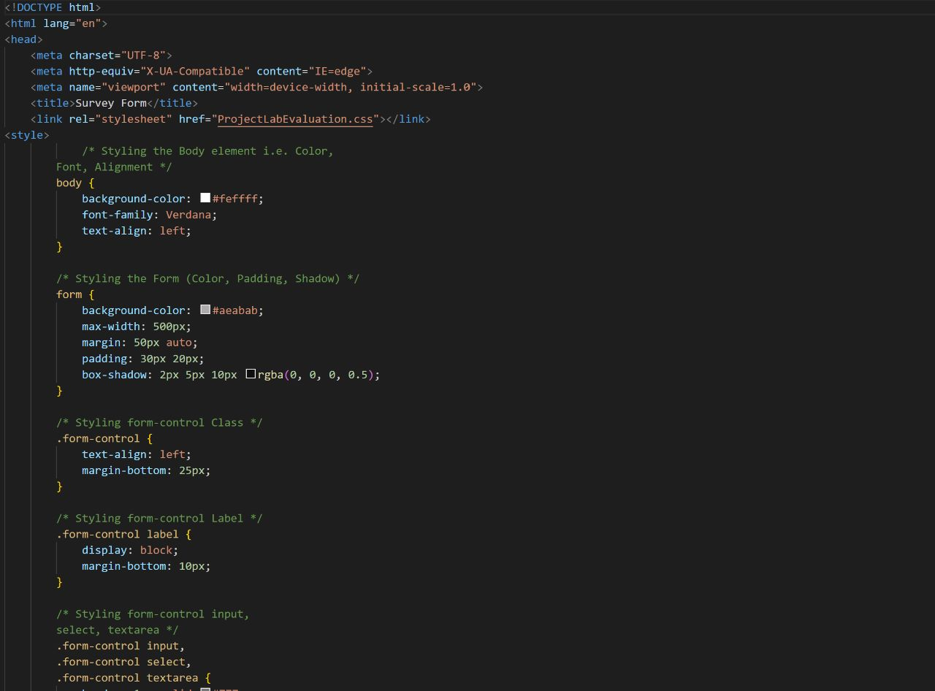

Slide 9
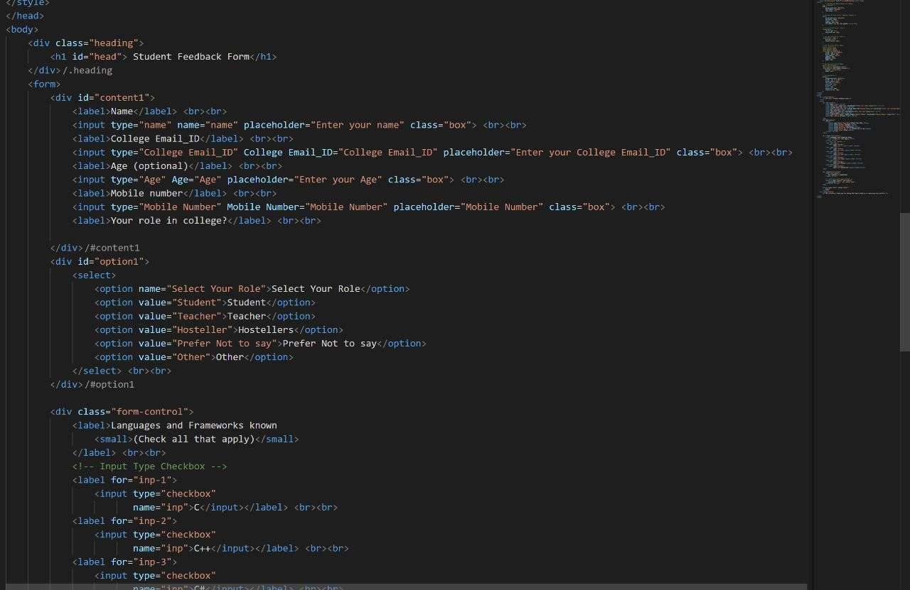

Slide 10
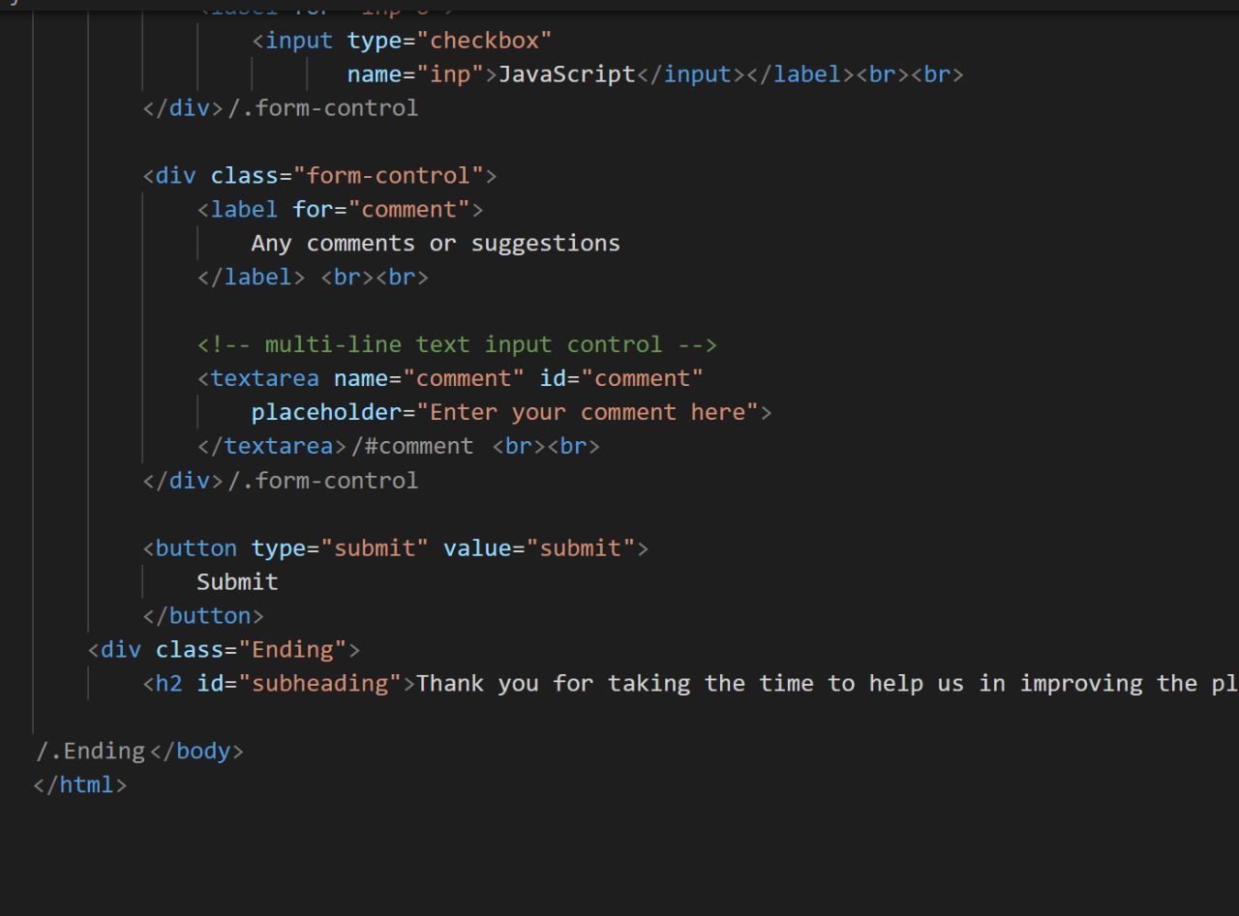

Slide 11
Bonus Feature(optional)
Target audience: Our survey form is designed to target a specific audience, which is the students and faculty of Chitkara University. To get people connected to carry-out more swift collaborations for research and projects. The data is able to gather more valuable insights and feedback.

Slide 12
Conclusion
In conclusion, our HTML and CSS survey form project provides an effective means of collecting data from both students and faculty, facilitating research and project collaborations. By creating a user-friendly interface with customizable fields, analytics and reporting, and accessibility features, we have developed a unique and valuable tool for gathering insights and feedback. We are confident that this survey form project will enable us to better understand the needs and preferences of our target audience, and help us to collaborate more effectively on future research and projects.

Slide 13
References/Links used
www.google.com for chitkara university’s photograph for background.

Slide 14


